Slide 1



Acceptability of Rabbit Manure as Alternative Briquette Enhanced with Sawdust
Atasha Mariz E. Marasigan
Marc Philip A. Landicho
Kate Ramielle M. Zurbito
Ashlee T. Macmac
May 7, 2024

Slide 2
Introduction
Due to population growth and industrialization, the demand for wood has escalated, leading to widespread deforestation. This has severe consequences like climate change and global warming. To combat this, researchers are exploring alternative fuel sources, and rabbit manure has emerged as a promising option.
Rabbit manure is readily available, particularly Santa Maria Laguna, where people are inclined towards in taking care of rabbit as their pet. It has the added benefit of producing methane, making it ideal for briquette production. These briquettes offer a sustainable and energy-efficient alternative to traditional wood fuel. Their use not only reduces deforestation but also improves air quality in urban areas.
Furthermore, rabbit manure is rich in nutrients like nitrogen, phosphorus, and potassium. When used as fertilizer, it improves soil drainage, moisture retention, and overall structure. This makes it a valuable resource for agriculture, especially compared to other types of manure which can be less user-friendly.
Overall, briquettes produced from rabbit manure offer a mutually beneficial solution. They address environmental concerns by minimizing deforestation and pollution, while also providing a valuable and sustainable fuel source. Additionally, their production and use promote a circular bioeconomy, supporting rural-urban connections and minimizing waste while promoting the use of renewable bioresources.

Slide 3
Statement of the Problem
This study specifically aims to discover the acceptability of rabbit manure as an alternative briquette.
1. Does the quality of the briquette satisfy needs based on the following:
1.1 Flammability;
1.2 Duration; and
1.3 Ignition
2. Is the briquette any good based on the following properties:
2.1 Odor; and
2.2 Size
3. Is there any significant relationship between effectiveness and appearance of the briquette.

Slide 4
Methodology
Creation of Briquette
Collection of Rabbit Manure
Drying of Rabbit Manure
Sifting the Rabbit Manure
Pulverize the Rabbit Manure
Molding the Rabbit Manure
Drying the Briquette

Slide 5
Results
As the null hypothesis indicates, which was failed to be rejected, there was a significant difference between the effectiveness and appearance of the briquette out of rabbit manure. Breaking it down, the following were findings drawn out from the study:
1. The texture of the odor of the briquette pleased the respondents as all of them strongly agreed that it was odorless.
2. For the duration of the fire, it was also satisfactory from the degree of agreeableness of the respondents.
3. The flammability of the briquette also pleased the respondents as all of them strongly agreed that the flame is continuous when it ignite, and it is enough to cook food.

Slide 6
Conclusions
Based on the findings, the researchers were able to conclude that the effectiveness of the briquette made of rabbit manure enhanced with sawdust was satisfactory as they strongly agreed to the positive characteristics of the product.
In addition, the appearance of the briquette out of rabbit manure enhanced with sawdust is commendable as it was much more appealing than the existing one with regards to the respondents’ answer to the questionnaire.
Furthermore, according to the survey responses gathered by the researchers, the odor of the briquette is praiseworthy. Some of them said that it has a nice scent that makes them think of being eco-friendly.
Also, there was a significant difference between its effectiveness and appearance.

Slide 7
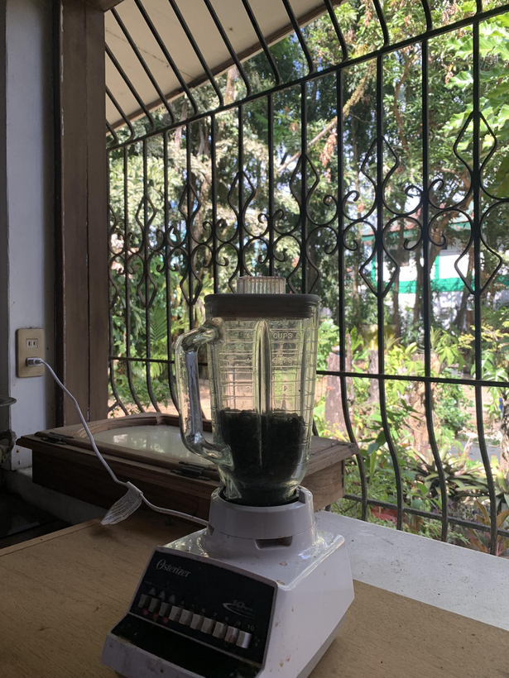
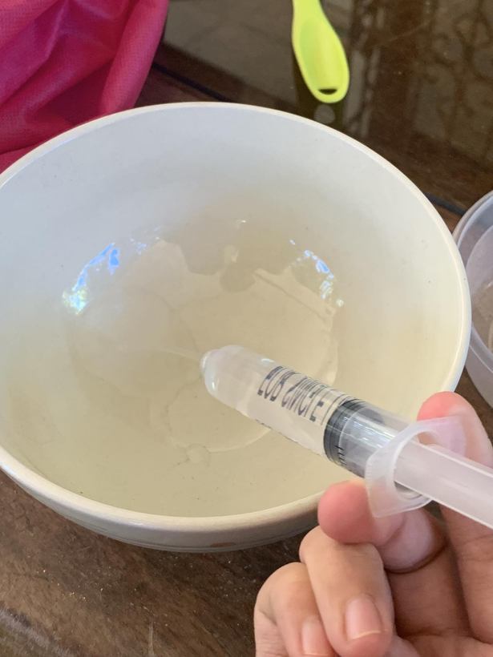
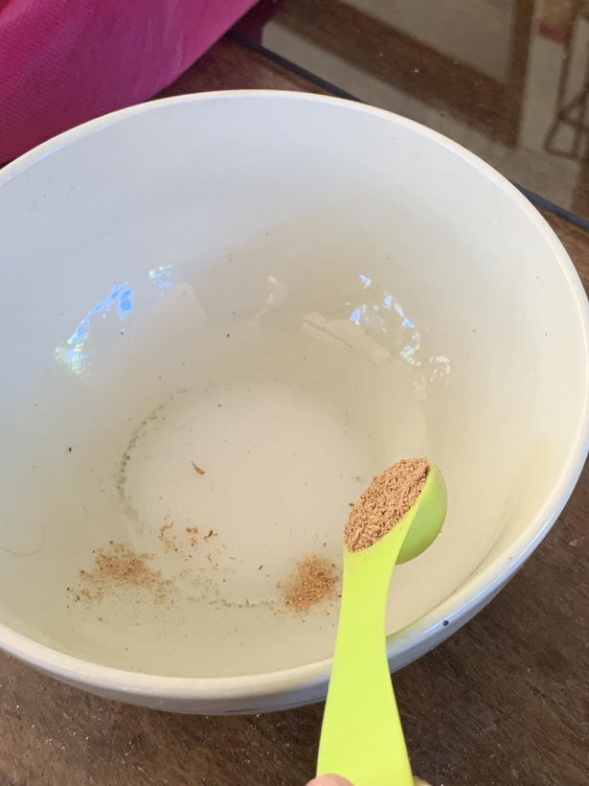
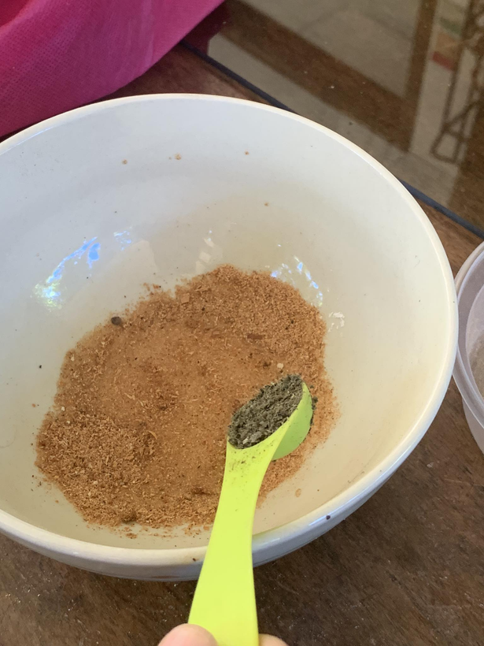
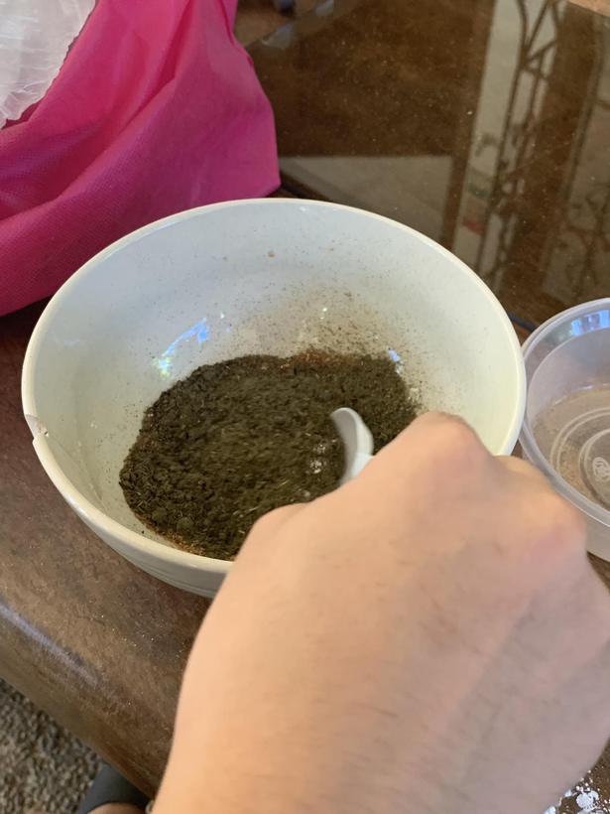
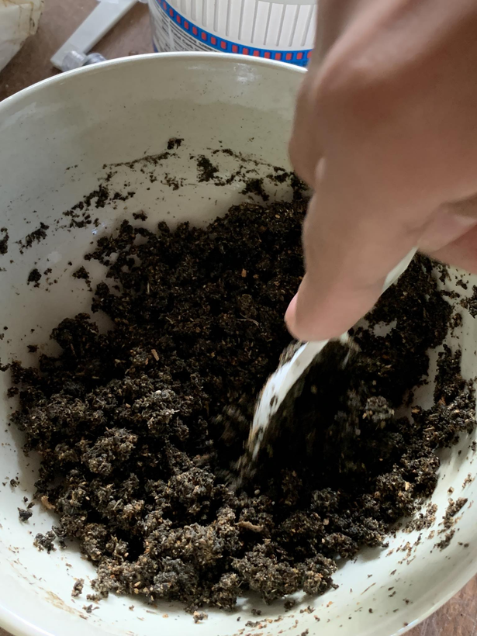
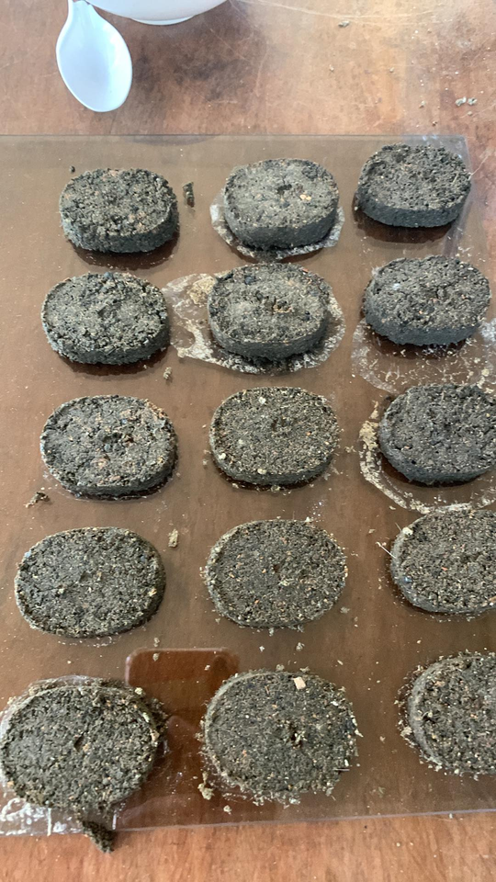
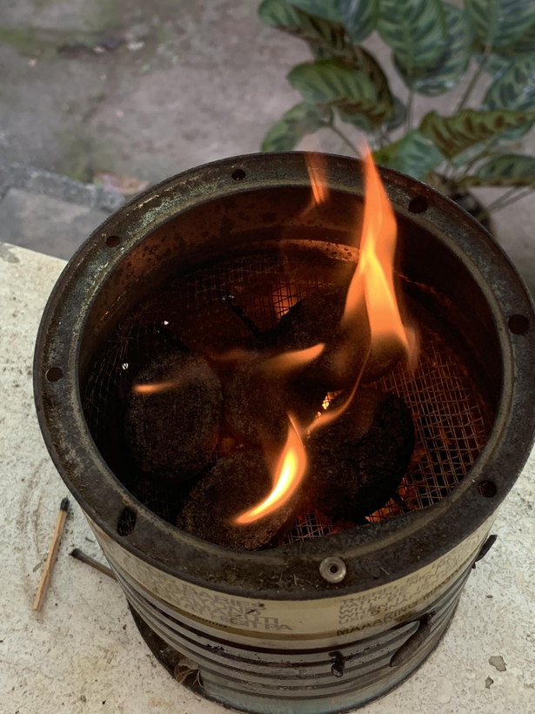
Story Board / Product Made

Slide 8
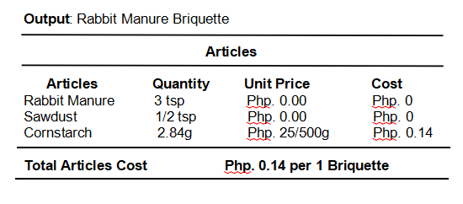
Cost Analysis

Slide 9
Thank
You!

